Slide 1

Composition
Sayan Mitra
Verifying cyberphysical systems
mitras@illinois.edu

Slide 2
Chapter 5

Slide 3
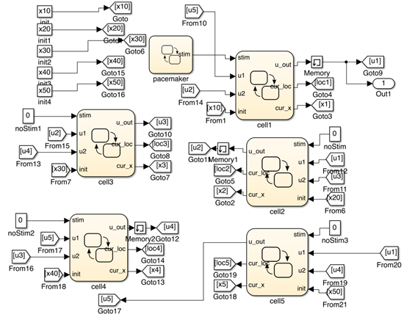
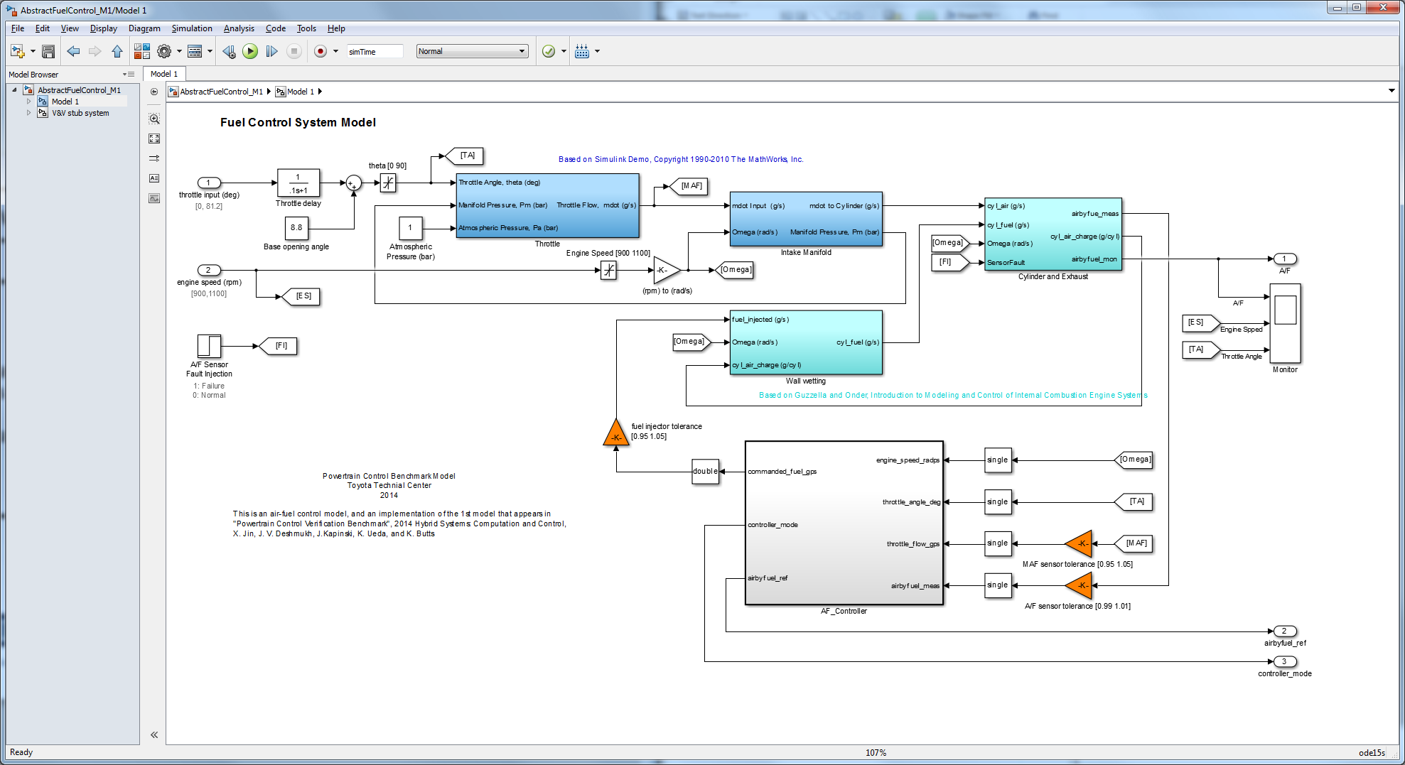
Why compose?
Complex models are built by putting together simpler components or modules
Composition: operation of putting together
Leads to precise definition of module interfaces
What properties are preserved under composition?
model of a network of oscillators [Huang et. al 14]
Powertrain model from Toyota [Jin et al. 15]

Slide 4
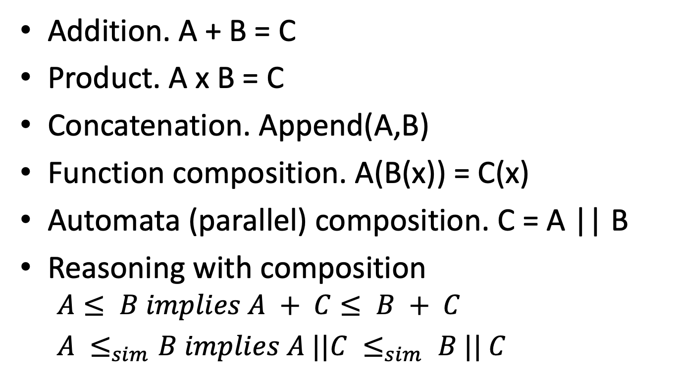
Examples of “composition”
Addition. A + B = C
Product. A x B = C
Concatenation. Append(A,B)
Function composition. A(B(x)) = C(x)
Automata (parallel) composition. C = A || B
Reasoning with composition
$$A≤ B implies A + C≤ B + C$$
$A ≤_{sim}B implies A ||C ≤_{sim} B || C$

Slide 5
Other examples of composition?
This of your notion of composition is captured by what we define

Slide 6
Outline
Composition operation
Input/output interfaces
I/O automata
hybrid I/O automata
Examples
Properties of composition

Slide 7
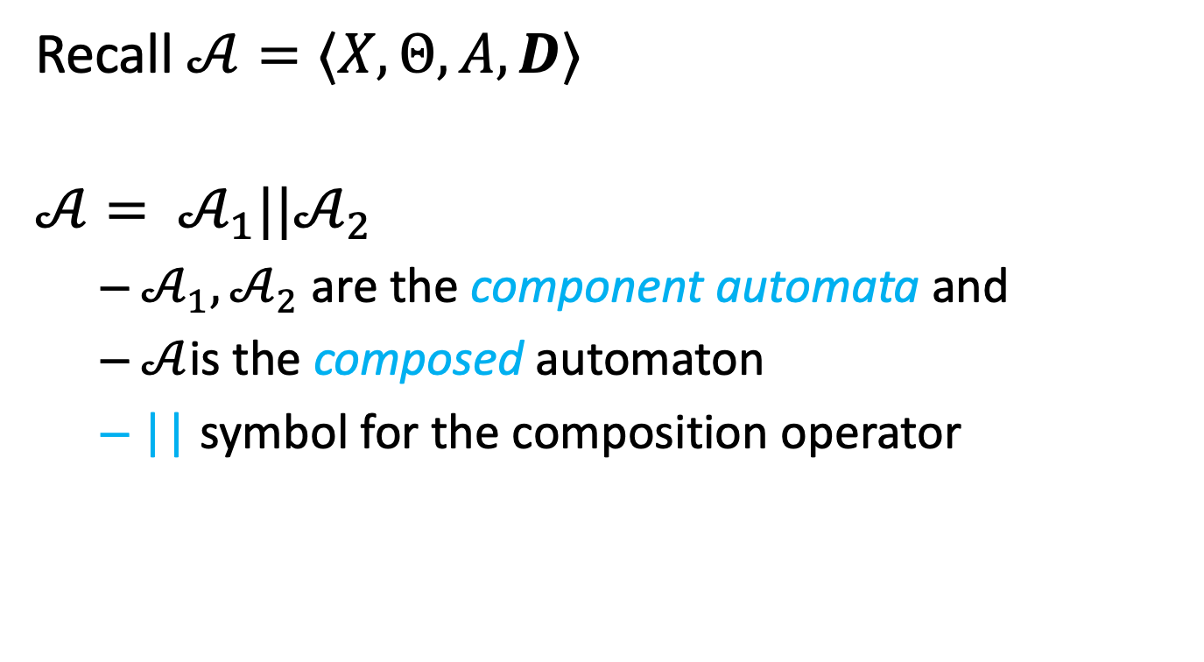
Composition of automata
Recall $𝒜=⟨X,Θ,A, D⟩$
$$𝒜= 𝒜_{1}||𝒜_{2}$$
$𝒜_{1}, 𝒜_{2}$ are the component automata and
$𝒜$is the composed automaton
|| symbol for the composition operator

Slide 8
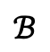


Sequential composition
$$𝒜$$
$$ℬ$$
$𝒜$.$ℬ$
In general, every final state has to be merged with every start state.
Not particularly interesting
a
d
a
b
e
b
c
f
c
d
e
f

Slide 9
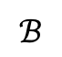

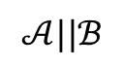
Parallel Composition: asynchronous transitions
$$𝒜||ℬ$$
$$𝒜$$
$$ℬ$$
a
d
a
d
b
d
a
e
b
e
c
d
b
e
a
f
c
e
b
f
c
f
c
f
$$𝒜||ℬ=⟨Q_{A}×Q_{B},Θ_{A}×Θ_{B},A, D⟩$$

Slide 10
parallel composition: synchronous transitions
$$𝒜$$
$$ℬ$$
a
d
a
d
b
d
a
e
b
e
c
d
b
e
a
f
c
e
b
f
c
f
c
f

Slide 11
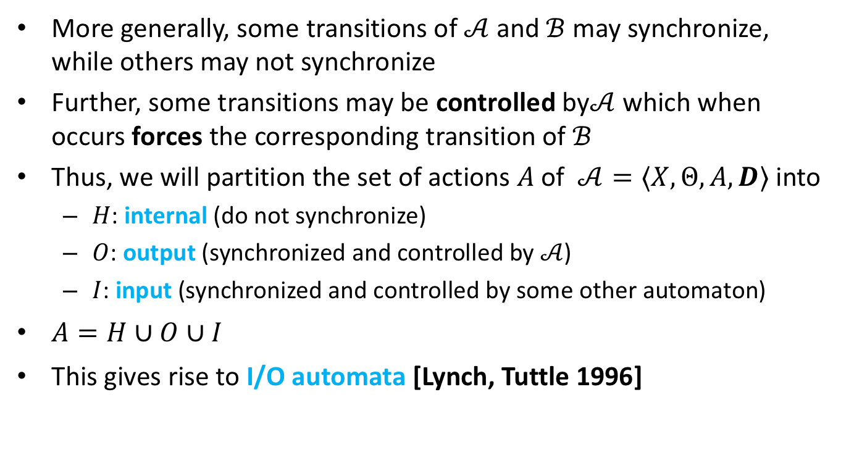
Composition of (discrete) automata
More generally, some transitions of $𝒜$ and $ℬ$ may synchronize, while others may not synchronize
Further, some transitions may be controlled by$𝒜$ which when occurs forces the corresponding transition of $ℬ$
Thus, we will partition the set of actions $A$of $𝒜=⟨X,Θ,A, D⟩$ into
$H$: internal (do not synchronize)
$O$: output (synchronized and controlled by $𝒜$)
$I$: input (synchronized and controlled by some other automaton)
$A=H∪O∪I$
This gives rise to I/O automata [Lynch, Tuttle 1996]

Slide 12
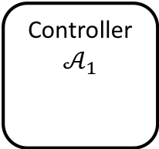
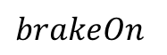
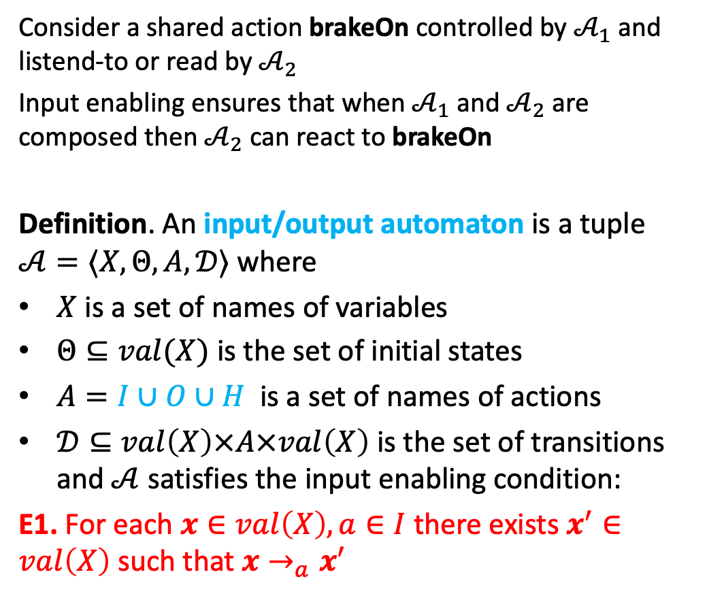
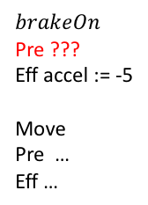
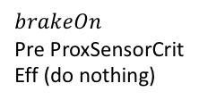
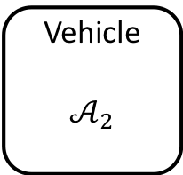
Reactivity: Input enabling
Consider a shared action brakeOn controlled by $𝒜_{1}$ and listend-to or read by $𝒜_{2}$
Input enabling ensures that when $𝒜_{1}$ and $𝒜_{2}$ are composed then $𝒜_{2}$ can react to brakeOn
Definition. An input/output automaton is a tuple $𝒜=〈X,Θ, A, 𝒟〉$ where
$X$ is a set of names of variables
$Θ⊆val(X)$ is the set of initial states
$A=I∪O∪H$ is a set of names of actions
$𝒟⊆val\left(X\right)×A×val\left(X\right)$ is the set of transitions and $𝒜$ satisfies the input enabling condition:
E1. For each $x∈val\left(X\right), a∈I$ there exists $x^{′}∈val\left(X\right)$ such that $x→_{a}x′$
Controller
$$𝒜_{1}$$
$$brakeOn$$
Pre ProxSensorCrit
Eff (do nothing)
$$brakeOn$$
Vehicle
$$𝒜_{2}$$
$$brakeOn$$
Pre ???
Eff accel := -5
Move
Pre …
Eff …

Slide 13
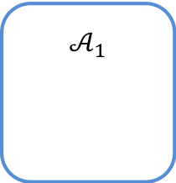
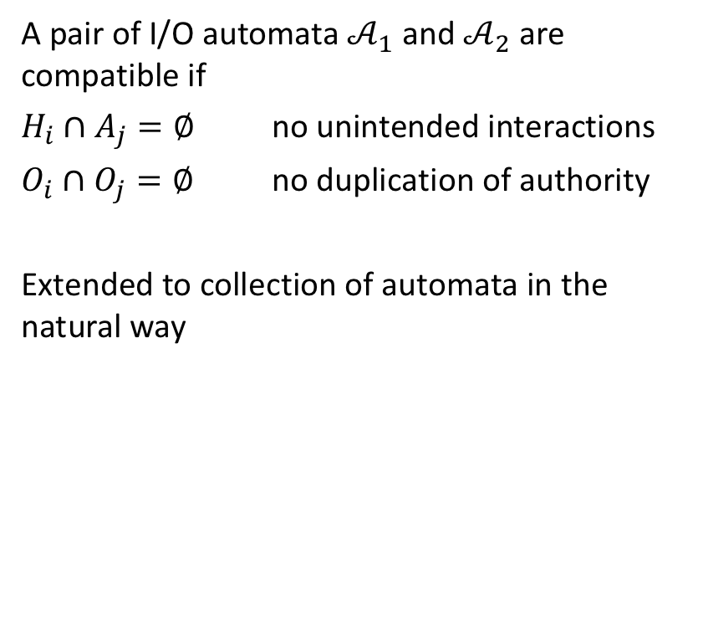
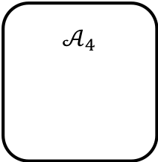
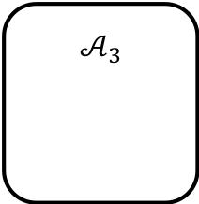
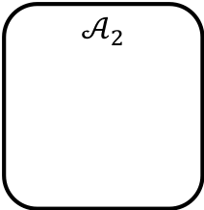
Compatibility IOA
$$𝒜_{1}$$
a
A pair of I/O automata $𝒜_{1}$ and $𝒜_{2}$ are compatible if
$H_{i}∩A_{j}=∅$ no unintended interactions
$O_{i}∩O_{j}=∅$ no duplication of authority
Extended to collection of automata in the natural way
b
c
$$𝒜_{2}$$
$$𝒜_{3}$$
d
e
f
$$𝒜_{4}$$

Slide 14
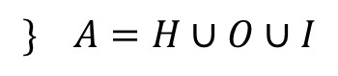
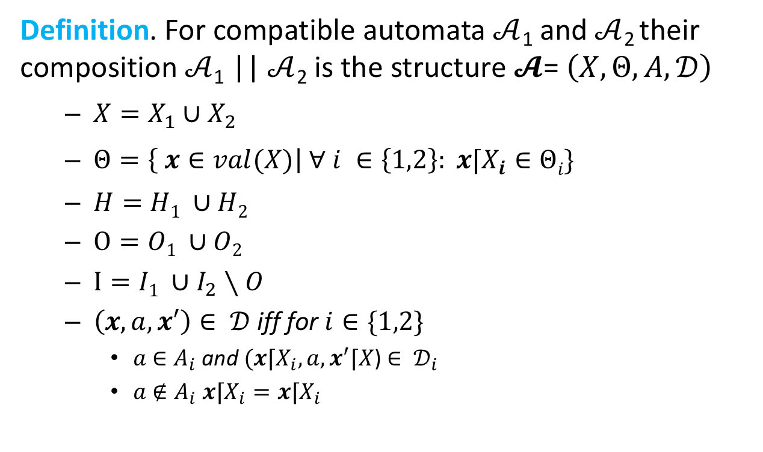
Composition of I/O automaton
Definition. For compatible automata $𝒜$₁ and $𝒜$₂ their composition $𝒜$₁ || $𝒜$₂ is the structure $𝓐$= $\left(X,Θ,A,𝒟\right)$
$X=X_{1}∪X_{2}$
$Θ=\left\{ x∈val(X)\right| ∀ i ∈\left\{1,2\right\}: x⌈X_{i}∈Θi\}$
$H=H1 ∪H2$
$O=O1 ∪O2$
$I=I1 ∪I_{2}∖O$
$\left(x,a,x′\right)∈ 𝒟$ iff for $i∈\{1,2\}$
$a$ $∈A_{i}$ and $(x⌈X_{i},a,x^{′}⌈X$) $∈ 𝒟_{i}$
$a$ $∉A_{i}$ $x⌈X_{i}=x⌈X_{i}$
$$\} A=H∪O∪I$$

Slide 15
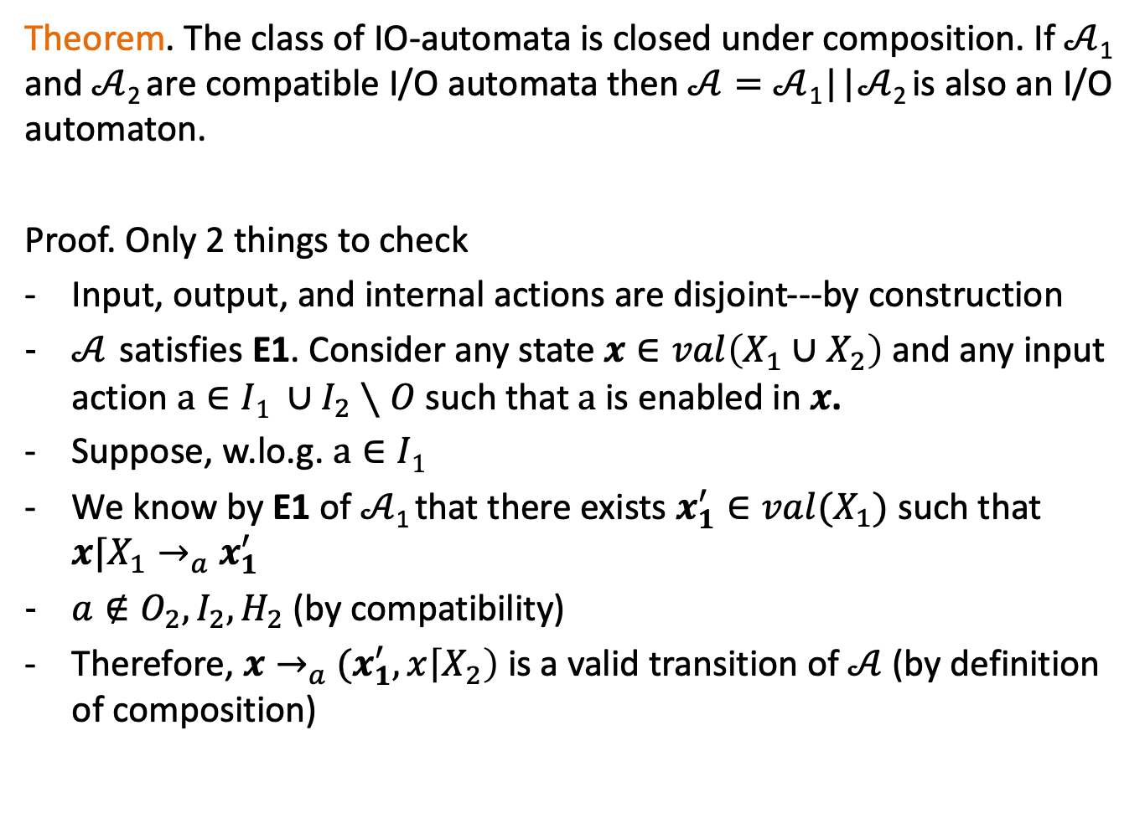
Theorem. The class of IO-automata is closed under composition. If $𝒜$₁ and $𝒜$₂ are compatible I/O automata then$𝒜=𝒜$₁||$𝒜$₂ is also an I/O automaton.
Proof. Only 2 things to check
Input, output, and internal actions are disjoint---by construction
$𝒜$ satisfies E1. Consider any state $x∈val\left(X_{1}∪X_{2}\right)$ and any input action$a∈I1 ∪I_{2}∖O$ such that $a$is enabled in $x$.
Suppose, w.lo.g. $a∈I1$
We know by E1 of $𝒜$₁ that there exists $x_{1}^{′}∈val(X_{1})$ such that $x⌈X_{1}→_{a}$ $x_{1}^{′}$
$a∉O_{2},I_{2},H_{2}$ (by compatibility)
Therefore, $x→_{a}$ $(x_{1}^{′},x\left\lceil X_{2}\right)$ is a valid transition of $𝒜$ (by definition of composition)

Slide 16
Example: Sending process and channel
System
Sender
Channel
Receiver
fail
send(m)
receive(m)
send(m)
~failed
Automaton Sender(u)
variables internal
failed:Boolean := F
output send(m:M)
input fail
transitions:
output send(m)
pre ~failed
eff
input fail
pre true
eff failed := T
Loc 1
failed
fail
true
failed := T

Slide 17
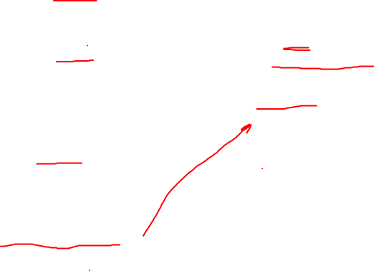
FIFO channel & Simple Failure Detector
Automaton Sender(u)
variables internal
failed:Boolean := F
output send(m:M)
input fail
transitions:
output send(m)
pre ~failed
eff
input fail
pre true
eff failed := T
Automaton System(M)
variables queue: Queue[M] := {}, failed: Bool
actions input fail
output send(m:M), receive(m:M)
transitions:
output send(m)
pre ~failed
eff queue := append(m, queue)
output receive(m)
pre head(queue)=m
eff queue := queue.tail
input fail
pre true
eff failed := true
Automaton Channel(M)
variables internal queue: Queue[M] := {}
actions input send(m:M)
output receive(m:M)
transitions:
input send(m)
pre true
eff queue := append(m, queue)
output receive(m)
pre head(queue)=m
eff queue := queue.tail

Slide 18
composing hybrid systems

Slide 19
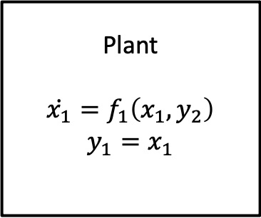
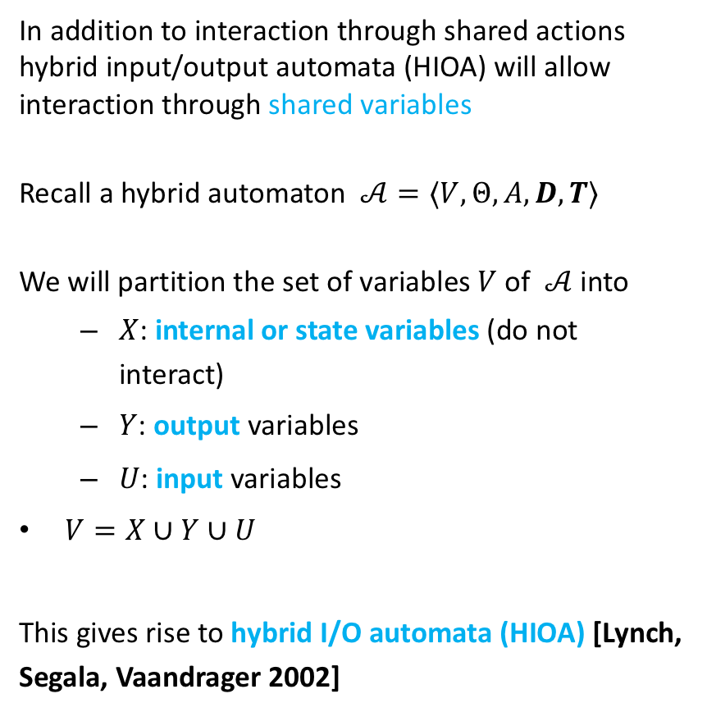
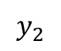
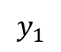
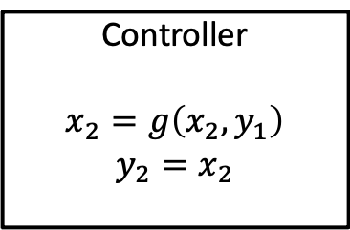
Hybrid IO Automaton
In addition to interaction through shared actions hybrid input/output automata (HIOA) will allow interaction through shared variables
Recall a hybrid automaton $𝒜=⟨V,Θ,A, D,T⟩$
We will partition the set of variables $V$of $𝒜$ into
$X$: internal or state variables (do not interact)
$Y$: output variables
$U$: input variables
$V=X∪Y∪U$
This gives rise to hybrid I/O automata (HIOA) [Lynch, Segala, Vaandrager 2002]
Plant
$$\dot{x_{1}}=f_{1}\left(x_{1},y_{2}\right)$$
$$y_{1}=x_{1}$$
$$y_{2}$$
$$y_{1}$$
Controller
$$x_{2}=g\left(x_{2},y_{1}\right)$$
$$y_{2}=x_{2}$$

Slide 20
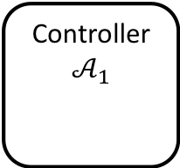
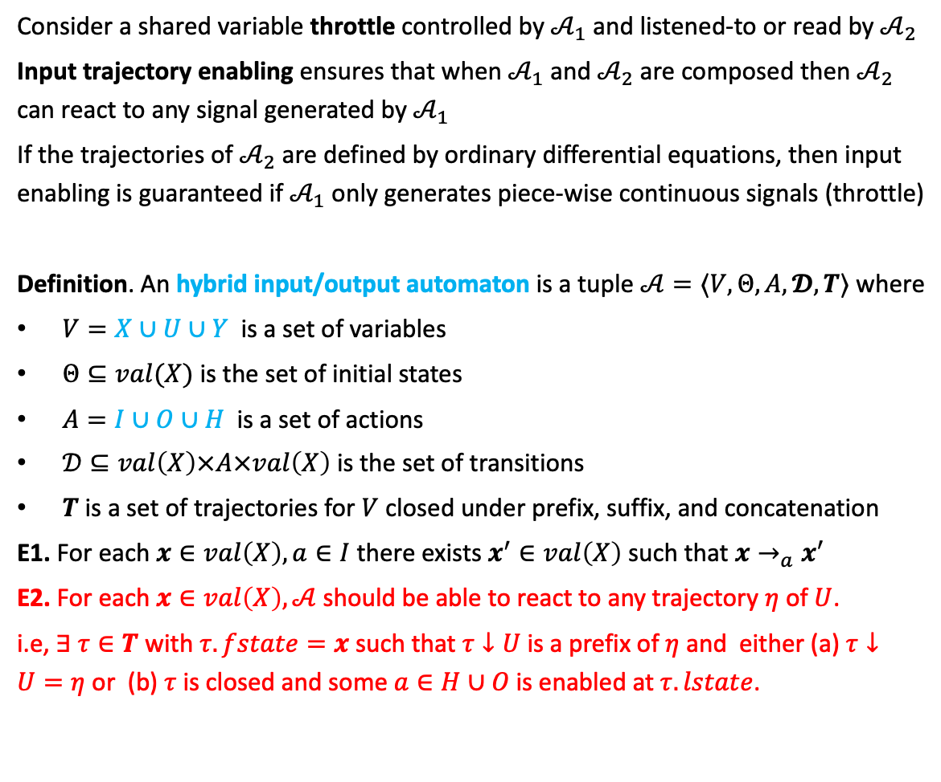
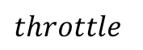

Reactivity: Input trajectory enabling
Consider a shared variable throttle controlled by $𝒜_{1}$ and listened-to or read by $𝒜_{2}$
Input trajectory enabling ensures that when $𝒜_{1}$ and $𝒜_{2}$ are composed then $𝒜_{2}$ can react to any signal generated by $𝒜_{1}$
If the trajectories of $𝒜_{2}$ are defined by ordinary differential equations, then input enabling is guaranteed if $𝒜_{1}$ only generates piece-wise continuous signals (throttle)
Definition. An hybrid input/output automaton is a tuple $𝒜=〈V,Θ, A, 𝓓,T〉$ where
$V=X∪U∪Y$ is a set of variables
$Θ⊆val(X)$ is the set of initial states
$A=I∪O∪H$ is a set of actions
$𝒟⊆val\left(X\right)×A×val\left(X\right)$ is the set of transitions
$T$ is a set of trajectories for $V$ closed under prefix, suffix, and concatenation
E1. For each $x∈val\left(X\right), a∈I$ there exists $x^{′}∈val\left(X\right)$ such that $x→_{a}x′$
E2. For each $x∈val\left(X\right), 𝒜$should be able to react to any trajectory $η$ of $U$.
i.e, $∃ τ∈T$ with $τ.fstate=x$such that $τ↓U$is a prefix of $η$ and either (a) $τ↓U=η$ or (b) $τ$ is closed and some $a∈H∪O$is enabled at $τ.lstate$.
Controller
$$𝒜_{1}$$
$$throttle$$
Vehicle
$$𝒜_{2}$$

Slide 21
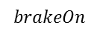
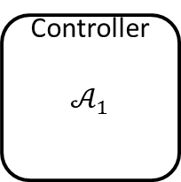
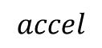
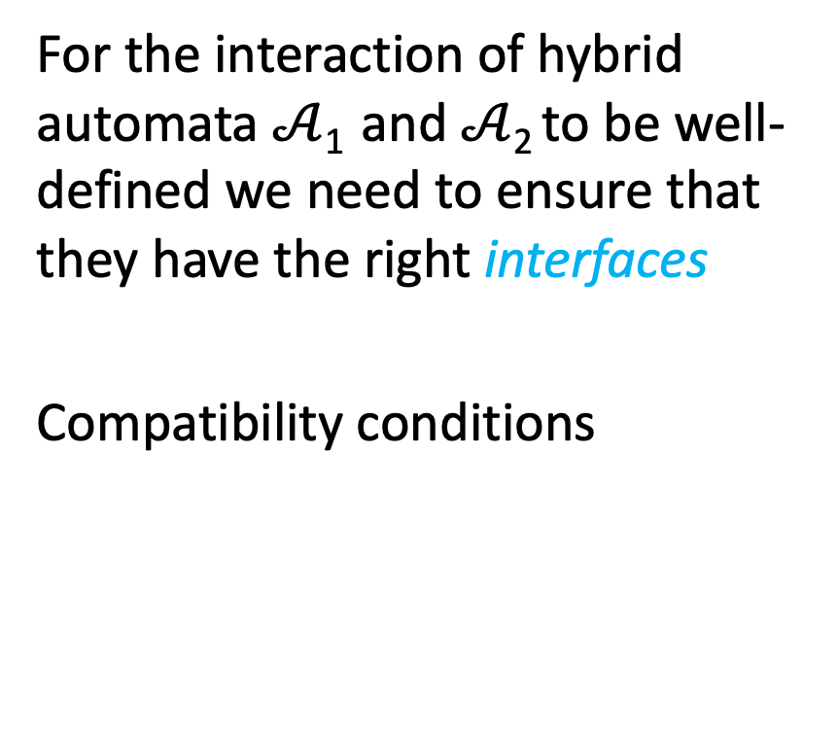
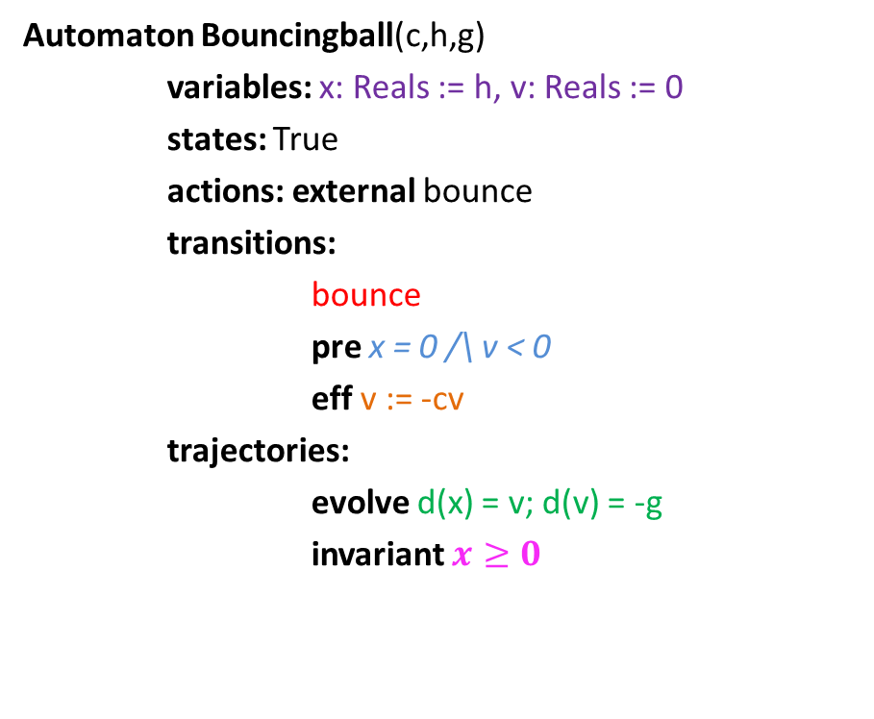
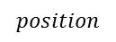
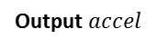
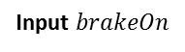
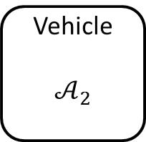
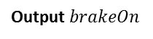
Compatibility of hybrid automata
For the interaction of hybrid automata $𝒜$₁ and $𝒜$₂ to be well-defined we need to ensure that they have the right interfaces
Compatibility conditions
Controller
$$𝒜_{1}$$
$$accel$$
Vehicle
$$𝒜_{2}$$
Output $accel$
Input $accel$
$$brakeOn$$
Output $brakeOn$
Input $brakeOn$
$$position$$

Slide 22
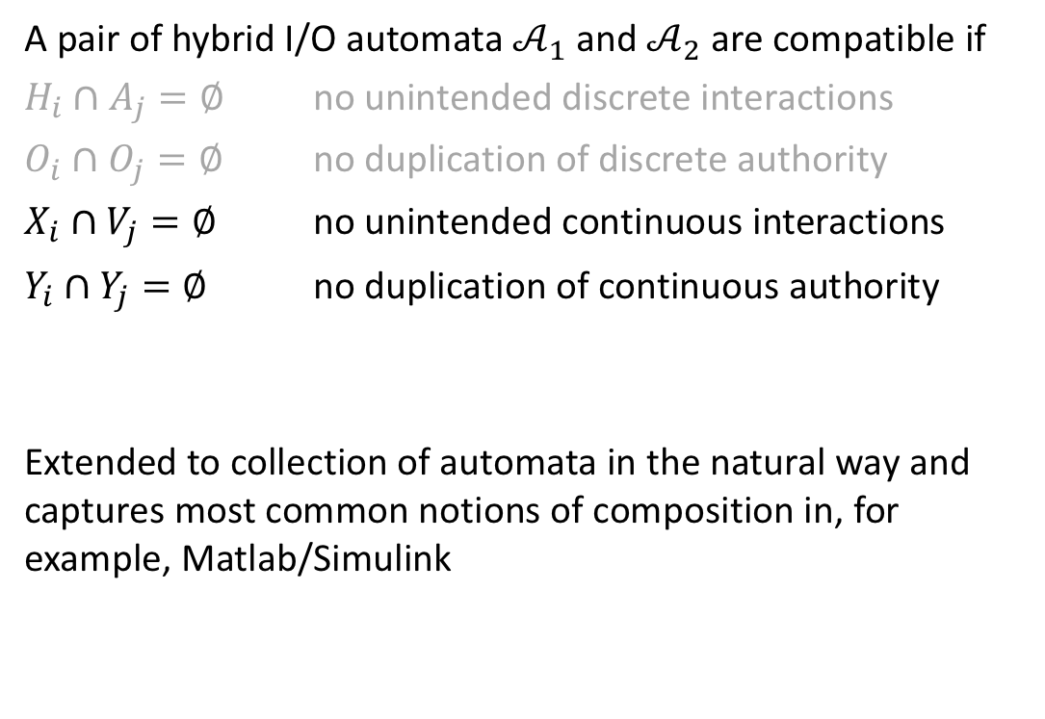
Compatibility HIOA
A pair of hybrid I/O automata $𝒜_{1}$ and $𝒜_{2}$ are compatible if
$H_{i}∩A_{j}=∅$ no unintended discrete interactions
$O_{i}∩O_{j}=∅$ no duplication of discrete authority
$X_{i}∩V_{j}=∅$ no unintended continuous interactions
$Y_{i}∩Y_{j}=∅$ no duplication of continuous authority
Extended to collection of automata in the natural way and captures most common notions of composition in, for example, Matlab/Simulink

Slide 23
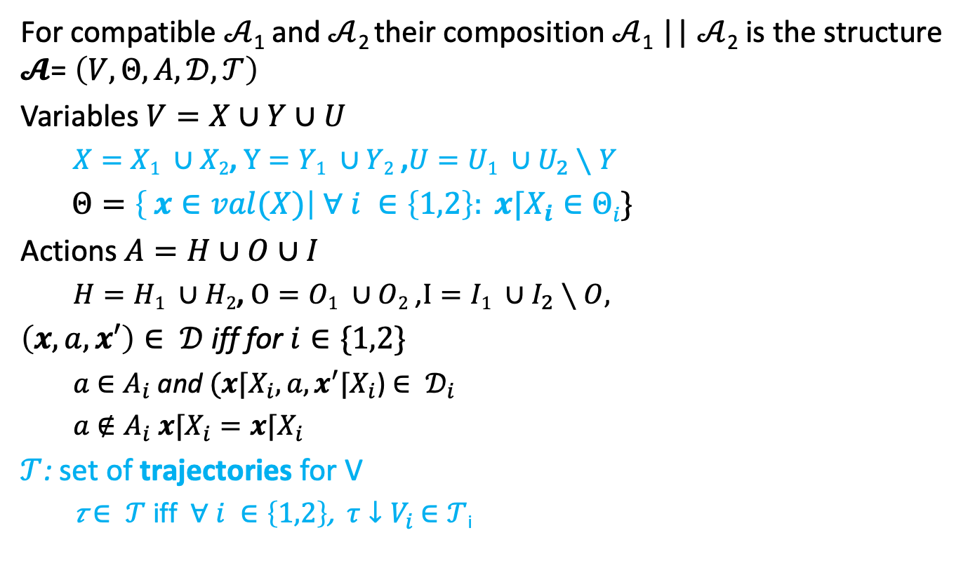
Composition
For compatible $𝒜$₁ and $𝒜$₂ their composition $𝒜$₁ || $𝒜$₂ is the structure $𝓐$= $\left(V,Θ,A,𝒟,𝒯\right)$
Variables $V=X∪Y∪U$
$X=X1 ∪X2$, $Y=Y1 ∪Y2$ ,$U=U1 ∪U_{2}∖Y$
$Θ=\left\{ x∈val(X)\right| ∀ i ∈\left\{1,2\right\}: x⌈X_{i}∈Θi\}$
Actions $A=H∪O∪I$
$H=H1 ∪H2$, $O=O1 ∪O2$ ,$I=I1 ∪I_{2}∖O,$
$\left(x,a,x′\right)∈ 𝒟$ iff for $i∈\{1,2\}$
$a$ $∈A_{i}$ and $(x⌈X_{i},a,x^{′}⌈X_{i}$) $∈ 𝒟_{i}$
$a$ $∉A_{i}$ $x⌈X_{i}=x⌈X_{i}$
$𝒯$: set of trajectories for V
𝜏 $∈ 𝒯$ iff $∀ i ∈\left\{1,2\right\}$, $τ↓V_{i}$ $∈𝒯$_{i}

Slide 24
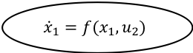
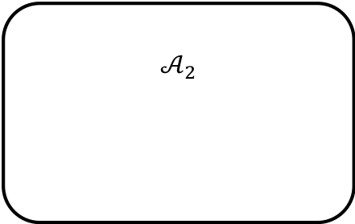
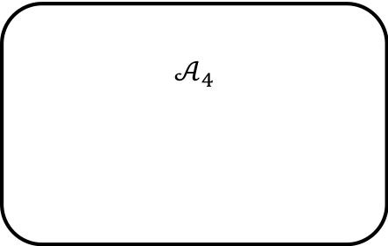
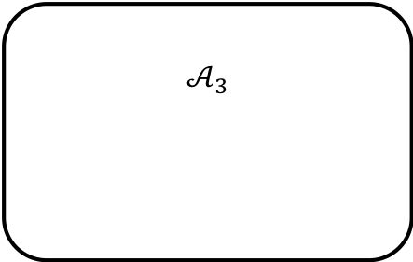
$$𝒜_{2}$$
u₂
u₂
$${\dot{x}}_{1}=f(x_{1},u_{2})$$
a₁
a₁
$$𝒜_{3}$$
a₁
e
e
f
f
a₁
$$𝒜_{4}$$

Slide 25
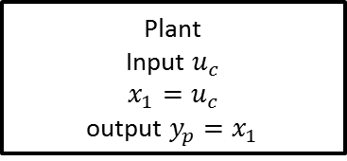
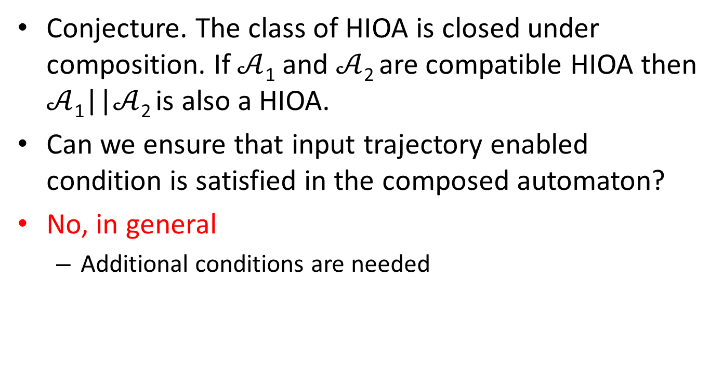
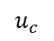


Closure under composition
Conjecture. The class of HIOA is closed under composition. If $𝒜$₁ and $𝒜$₂ are compatible HIOA then $𝒜$₁||$𝒜$₂ is also a HIOA.
Can we ensure that input trajectory enabled condition is satisfied in the composed automaton?
No, in general
Additional conditions are needed
Plant
Input $u_{c}$
$$x_{1}=u_{c}$$
output $y_{p}=x_{1}$
$$u_{c}$$
$$y_{p}$$
Controller
Input $y_{p}$
$$x_{2}=y_{p}+1$$
Output $u_{c}=x_{2}$

Slide 26





Hybrid IO Automaton
In addition to interaction through shared actions will allow interaction through shared variables
Set of variables partitioned as $V=X∪U∪$ Y
X: set of internal variables (not involved in interactions)
Y: set of output variables
U: set of input variables
Note. Given a trajectory of $u_{c}$, say $η$, and initial state $x_{0}, τ$ is a valid trajectory of $x_{1}$ if for all t
$\frac{d}{dt}\left(τ↓x_{1}\right)\left(t\right)=f_{1}(τ\left(t\right), η\left(t\right))$ and
$τ\left(0\right)=x_{0}$
Plant
Input $u_{c}$
$$\dot{x_{1}}=f_{1}\left(x_{1},u_{c}\right)$$
output $y_{p}=x_{1}$
$$u_{c}$$
$$y_{p}$$
Controller
Input $y_{p}$
$$x_{2}=g\left(x_{2},y_{1}\right)$$
Output $u_{c}=x_{2}$

Slide 27


Example 2: Periodically Sending Process
Automaton PeriodicSend(u)
variables internal
clock: Reals := 0, z:Reals, failed:Boolean := F
signature output send(m:Reals)
input fail
transitions:
output send(m)
pre clock = u /\ m = z /\ ~failed
eff clock := 0
input fail
pre true
eff failed := T
trajectories:
evolve d(clock) = 1, d(z) = f(z)
invariant failed \/ clock$≤$u
send(m)
clock = u /\ m = z /\ ~failed
clock := 0
Loc 1
$$d\left(clock\right)=1$$
$$d\left(z\right)=f(z)$$
~failed$⇒clock≤u$
clock:= 0
fail
true
failed := T

Slide 28


Time bounded channel & Simple Failure Detector
Automaton Timeout(u,M)
variables: suspected: Boolean := F,
clock: Reals := 0
signature input receive(m:M)
output timeout
transitions:
input receive(m)
pre true
eff clock := 0; suspected := false;
output timeout
pre ~suspected /\ clock = u
eff suspected := true
trajectories:
evolve d(clock) = 1
invariant clock $≤$ u \/ suspected
Automaton Channel(b,M)
variables internal queue: Queue[M,Reals] := {}
clock: Reals := 0
signature input send(m:M)
output receive(m:M)
transitions:
input send(m)
pre true
eff queue := append(<m, clock+b>, queue)
output receive(m)
pre head(queue)[1]=m $∧$
head(queue)[2]=clock
eff queue := queue.tail
trajectories:
evolve d(clock) = 1
invariant $∀$<m,d>∈ queue: d $≥$ clock

Slide 29
Example 3: Oscillator and pulse generator
pulseGen
Oscillator

Slide 30




Composed automaton
On,Mode
$$d\left(now\right)=1$$
$$d\left(x_{1}\right)=−x_{1}\left(x_{1}^{2}+0.9x_{1}+0.9\right)−x_{2}+1$$
$$d\left(x_{2}\right)=x_{1}−2x_{2}$$
$$now≤T_{On}$$
Oscillator1
pre:$now≥T_{Off}$
eff: $now≔0$
pre:$now≥T_{On}$
eff: $now≔0$
Oscillator6
Oscillator2
pulseGen
Off,Mode
$$d\left(now\right)=1$$
$$d\left(x_{1}\right)=−x_{1}\left(x_{1}^{2}+0.9x_{1}+0.9\right)−x_{2}+0$$
$$d\left(x_{2}\right)=x_{1}−2x_{2}$$
$$now≤T_{Off}$$
Oscillator5
Oscillator3
Oscillator4
Cardiac oscillator network models, Grosu et al. CAV, HSCC 2007-2015

Slide 31

Restriction operation on exections
Sometimes it is useful to restrict our attention to only some subset of variables and actions in an execution
Recall the restriction operations $x⌈V and τ↓V$
Let $α=τ_{0}a_{1}τ_{1}a_{2}$ be an execution fragment of a hybrid automaton with set of variables $V$ and set of actions $A$. Let $A′$ be a set of actions and $V′$ be a set of variables.
Restriction of $α$to $(A′,V′)$, written as $α⌈(A′, V′)$ is the sequence defined inductively as:
$α⌈\left(A^{′},V^{′}\right)$ = $τ↓V^{′}$ if $α=τ$
$α a τ ⌈\left(A^{′},V^{′}\right)$ =
$α ⌈\left(A^{′},V^{′}\right) a (τ↓V^{′})$ if $a∈A′$
$α ⌈\left(A^{′},V^{′}\right) concat (τ↓V^{′})$ if $a∉A^{′}$
From the definition it follows $α.lstate ⌈V^{′}=α⌈\left(A′,V^{′}\right).lstate$ for any $A^{′},V′$

Slide 32

Properties of Compositions
Proposition. Let $𝒜= 𝒜_{1}||𝒜_{2}$. $α$ is an execution fragment of $𝒜$ iff
$α⌈\left(A_{i},V_{i}\right), i∈\left\{1,2\right\}$ are both execution fragments of $𝒜_{i}.$
Proof of the forward direction. Fix $α$ and i. We prove this by induction on the length of $α.$
Base case: $α=τ.$ $α⌈\left(A_{i},V_{i}\right)=τ↓V_{i}$ by definition of composition $τ↓V_{i}∈T_{i}$. So, $τ↓V_{i}∈Frag_{i}$
$α=α′ a τ ⌈\left(A_{i},V_{i}\right)$ and $a∈A_{i}$ and by induction hypothesis $α′⌈\left(A_{i},V_{i}\right)∈Frag_{i}$. Let $α′⌈\left(A_{i},V_{i}\right).lstate$= $v.$ By the definition of composition: $τ↓V_{i}∈T_{i}$.
It remains to show that $v⌈V_{i}→_{a}\left(τ↓V_{i}\right).fstate.$Since $a∈A_{i},$by the definition of composition: $α′⌈\left(A_{i},V_{i}\right).lstate →_{a}τ↓V_{i}.fstate$
$α=α′ a τ ⌈\left(A_{i},V_{i}\right)$ and $a∉A_{i}$ and by induction hypothesis $α′⌈\left(A_{i},V_{i}\right)∈Exec_{i}.$Let $τ′$ be the last trajectory in that execution.
Since $a∉A_{i},$by the definition of composition:$τ^{′}.lstate=τ↓V_{i}.fstate$. By concatenation closure of $Τ_{i}$, it follows that $τ^{′}concat τ↓V_{i}∈Τ_{i}.$ Therefore $α⌈\left(A_{i}, V_{i}\right)∈Exec_{i}$.
Notes:
Fix 1.

Slide 33

properties of executions of composed automata
$α$ is an execution iff $α⌈\left(A_{i},V_{i}\right), i∈\left\{1,2\right\}$ are both executions.
$α$ is time bounded iff $α⌈\left(A_{i},V_{i}\right), i∈\left\{1,2\right\}$ are both time bounded.
$α$ is admissible iff $α⌈\left(A_{i},V_{i}\right), i∈\left\{1,2\right\}$ are both admissible.
$α$ is closed iff $α⌈\left(A_{i},V_{i}\right), i∈\left\{1,2\right\}$ are both closed.
$α$ is non-Zeno iff $α⌈\left(A_{i},V_{i}\right), i∈\left\{1,2\right\}$ are both time non-Zeno.

Slide 34
Summary
Composition operation
I/O interfaces: actions and variables
Reactivity/input enabling
(non) Closure under composition
Properties of executions preserved under composition
Inductive invariants

